Slide 1
Training
E.P.S.D.T.

Slide 2
Learning Objectives:
By the end of this training, you will be able to:
Understand what EPSDT means and who it applies to.
Understand EPSDT requirements
Advise providers on how to use E.P.S.D.T benefits to help eligible members access needed care irrespective of coverage in the program

Slide 3
Contents:
What is E.P.S.D.T.?
What dental services qualify under E.P.S.D.T?
What is the Medically Necessity standard under E.P.S.D.T?
When is a Treatment Authorization Request (TAR) required under E.P.S.D.T.?
What happens when a procedure was rendered, and TAR was not submitted?
What can a Provider tell their patients about E.P.S.D.T?
Are dental services to resolve medical conditions covered under E.P.S.D.T?
Are Orthodontic services covered under E.P.S.D.T.?
What kind of information does the Plan need to determine medical necessity?
Where can we obtain the most current information for E.P.S.D.T. requirements under Medi-Cal Dental?

Slide 4
What is E.P.S.D.T.
E.P.S.D.T. = Early
Periodic
Screening,
Diagnostic and
Treatment Services
The EPSDT benefit allows Medi-Cal enrolled children and youth under age 21 to get preventive (screening) dental services and to get diagnostic and treatment services that are medically necessary to correct or ameliorate health conditions found during screening.

Slide 5
Requirement under Law:
requirements in Section 1905(r) of the Social Security Act and Title 42 Code of Federal Regulations Section 441.50 et seq, and specifically CFR 441.56(b)(1)(vi),
the Department of Health Care Services (DHCS) is responsible for providing full-scope Medi-Cal members under the age of 21 with a comprehensive, high-quality array of preventive (such as screening), diagnostic, and treatment services under EPSDT.
Further, consistent with state and federal law and regulations for EPSDT, the Medi-Cal Dental Program covers all services that are medically necessary under EPSDT, including those to “correct or ameliorate” defects and physical and mental illness or conditions.
These services are without cost for the member.

Slide 6
Medically Necessity standard under E.P.S.D.T.
EPSDT benefit entitles enrollees under the age of 21 to any treatment or procedure that fits within any of the categories of Medicaid-covered services listed in the SSA, Section 1905(a), regardless of whether or not the service is covered under the Medi-Cal State Plan or is listed in the Manual of Criteria, if that treatment or service is necessary to “correct or ameliorate” defects and physical and mental illnesses or conditions, meaning that the service is medically necessary under EPSDT.
Effective January 1, 2019, Welfare and Institutions Code section 14059.5 distinguishes the definition of medical necessity for individuals 21 and older compared with the definition for those under 21. For individuals younger than 21 years of age, services are determined to be medically necessary when needed to correct or ameliorate defects and physical and mental illnesses or conditions.
A service need not cure a condition in order to be covered under EPSDT. Services that maintain or improve the child’s current health condition are also covered in EPSDT because they “ameliorate” a condition. Maintenance services are defined as services that sustain or support rather than those that cure or improve health problems. Services are covered when they prevent a condition from worsening or prevent development of additional health problems. The common definition of “ameliorate” is to “make more tolerable.”
Medi-Cal members under age 21 may require dental services that are not part of the current Medi-Cal Dental Program scope of benefits. Conversely, the dental service may be part of the Medi-Cal Dental Program scope of benefits for adult members but not for members under the age of 21, or the dental provider may want to provide the service at a frequency or periodicity greater than currently allowed by the Medi-Cal Dental Program. In these cases, the child member may still be eligible for these services based upon submitted documentation that demonstrates the medical necessity to correct or ameliorate the child’s condition.

Slide 7
Treatment Authorization Request (TAR) required under E.P.S.D.T.
Providers must submit a TAR when a member under the age 21 needs an EPSDT medically necessary service, if it would not be covered by the Medi-Cal Dental program.
1. To perform a dental procedure that is not listed in the Manual of Criteria:
Providers should use the appropriate Current Dental Terminology (CDT) procedure code. Providers should not limit their comments to Field 34 of the TAR/Claim form but submit all documents that are needed to describe and support the medical necessity for the requested service(s).
  E.g.: Alicia M. (age 12) has fractured an anterior tooth in an accident. Although only three surfaces were involved in the traumatic destruction, the extent is such that a bonded restoration will not be retentive. With adequate documentation (in this case, intraoral photographs of the fractured tooth) and narrative explanation by the dentist, a prefabricated or laboratory-processed crown may be authorized as an EPSDT service.

Slide 8
Treatment Authorization Request (TAR) required under E.P.S.D.T.
Continued…
2. To perform a dental procedure that is listed in the Manual of Criteria when the member under the age of 21 does not meet the published criteria:
  Providers should fully document the medical necessity to demonstrate it will correct or ameliorate the member’s condition.
  Example 1: John S. (age 17) has a craniofacial anomaly with multiple edentulous areas. The edentulous areas cannot be adequately restored using conventional prosthetics – an implant-retained fixed prosthesis may be authorized as an EPSDT Service.
  Example 2: Cindy T. (age 10) suffers from aggressive periodontitis and requires periodontal scaling and root planning. The Manual of Criteria states this procedure is not a benefit for patients under 13 years of age. However, as a documented medically necessary periodontal procedure, it may be authorized as an EPSDT service when there is radiographic evidence of bone loss

Slide 9
Treatment Authorization Request (TAR) required under E.P.S.D.T.
Continued…
  To perform a dental procedure when the member under the age of 21 needs a dental service more frequently than is specified in the Manual of Criteria
Providers should fully document the medical necessity to demonstrate it will correct or ameliorate the member’s condition.

Slide 10
Submission of Claim without TAR for E.P.S.D.T.
Where a TAR was not submitted for a procedure in which an EPSDT medically necessary service was needed, the provider must submit a claim with all documentation to support the medical necessity. The provider shall also indicate the reason that a TAR was not submitted

Slide 11
Provider Responsibility to Member about E.P.S.D.T
Leveraging both written materials and in person or over the phone dialogue, dental providers should inform Medi-Cal members under age 21, or their parents, about EPSDT benefits and services and how to access them. Providers should tell eligible patients and their families about all of the following
The value of preventive services and screenings.
The services available under EPSDT.
Where and how to obtain EPSDT services.
EPSDT services are free to eligible individuals under age 21.

Slide 12
Coverage of Dental Services under E.P.S.D.T. to Resolve Medical Conditions
In some cases, dental services are necessary to resolve or improve an associated medical condition.
  For example, a child’s speech therapist determines that a diagnosed speech defect or disorder cannot be resolved without dental treatment. A consultation letter from the speech therapist should be included with the TAR/Claim form.
Example: Andre W. (age 13) does not qualify for orthodontic services per the handicapping malocclusion criteria (he scores below 26 points on the HLD Index Score Sheet or does not have one of the six automatic qualifying conditions). However, a speech pathologist has determined that his malocclusion is a prime etiologic factor in his speech pathosis – resolution cannot be achieved unless his malocclusion is corrected. In this case, orthodontics may be authorized as an EPSDT service.

Slide 13
Orthodontic Services under E.P.S.D.T.
A TAR for orthodontic services when the child or youth under the age of 21 does not have one of the six automatic qualifying conditions or does not score 26 points or above, must include a completed Handicapping Labio-Lingual Deviation (HLD) Index Score Sheet (DC-016 09/18) in addition to other documentation requirements listed in the Manual of Criteria. The review of active orthodontic services also requires the submission of diagnostic casts.
The provider is required to submit all documentation required for the procedure per the Manual of Criteria and the clinical information required to determine medical necessity under EPSDT guidelines.

Slide 14
Clinical Information needed by LIBERTY to Determine Medical Necessity
Providers must consult the Manual of Criteria, to identify the documentation and clinical information required for submittal to determine medical necessity under EPSDT guidelines.

Slide 15
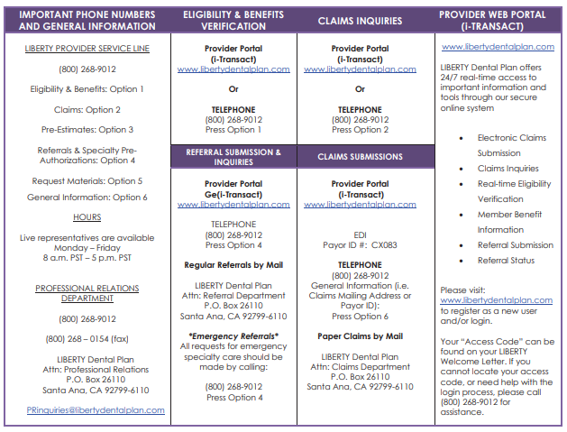
Additional Resources for the Provider:
PROVIDER CONTACT AND INFORMATION GUIDE

Slide 16
Thank you.

